Slide 1
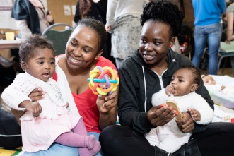
Magpie Project
The Magpie Project are an organisation providing support and advice to mothers and children under five who are in temporary or insecure accommodation in Newham. The Evaluation Exchange UCL research team is made up Paula Oliveira (Research Associate in Clinical Education Health Psychology), Emma Laycock (PhD candidate in UCL Cancer Institute), Masuma Mishu (PhD candidate in Epidemiology and Public Health) and Fran Harkness (PhD candidate in Epidemiology and Public Health). Since September 2017 The Magpie Project and UCL researchers have been working together to development a robust, workable evaluation framework for the Magpie Project. This has involved developing a Theory of Change, alongside a simple visual evaluation tool to be used with mothers involved in the Magpie Project.
Key lessons learnt:
An important step to develop the evaluation framework was clarifying what evaluation data is really needed by the Magpie Project and why, as it can be tempting to capture everything! Through developing the theory of change the team could unpack which information is essential to capture, to understand and evidence the changes the Magpie Project is making.
When designing the evaluation methods the team carefully considered the people, i.e. the mothers and children, who will be involved the evaluation. As they did not want to make assumptions about information they will or won’t provide, they spent time talking to those who they want to collect data from to find out their thoughts. The result was a simple visual evaluation tool, which is about to be trialed.
“I have used the Evaluation Exchange as an example in job interviews. It has been a real advantage to have demonstrated these skills in a real life setting and demonstrate my impact” (UCL researcher).
Next steps
Key impacts
Apart from the introduction of the evaluation framework to the Magpie Project, the team have become good friends and are planning to stay in touch with each other after the end of the Evaluation Exchange.
The researchers have reported that the Evaluation Exchanges has enabled them to use and apply their research skills in a real-world setting, and this its has been a valuable, worthwhile experience.
Both the researchers and the Magpie project have learnt more about evaluation, notably how to create a theory of change.
The Evaluation Exchange provided an opportunity for researchers to work in a multidisciplinary team. All described this as a positive, rewarding experience.
“Our researchers are outstanding” (the Magpie Project)

Slide 2
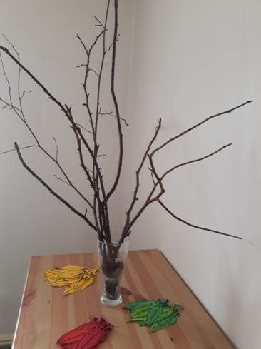
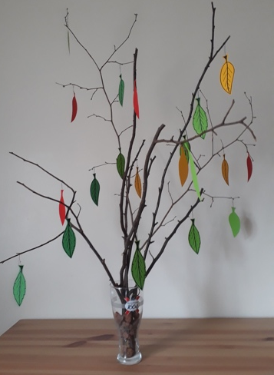
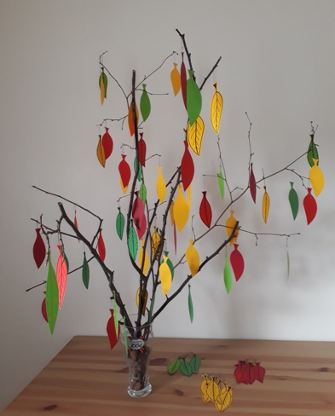
IROKO
IROKO is a theatre company that uses traditional African theatre, storytelling, and the arts to advance the education, skills, health, and wellbeing of people from all backgrounds. One of their current projects, Reaching Out, uses African drumming to enhance social communication and quality of life for people with dementia and their carers. The Evaluation Exchange UCL research team is made up of Kyle Lee-Crossett (PhD candidate in Heritage Studies), Fernanda Garcia Alba Garciadiego (PhD candidate in Civil and Environmental Engineering), and Mandy Ho (PhD candidate in Experimental Psychology). Since September 2017 IROKO and UCL researchers have been working together to develop evaluation tools that can be applied in the Reaching Out project and other IROKO initiatives.
Key impacts
The team had learn from scratch what it means to evaluate workshops and non profit services – it was a steep learning curve. The team have learnt a lot about applying evaluation techniques in the real world, rather than just thinking about them abstractly.
Key lessons learnt:
The fact that the team come from different disciplines is important. Together they offered a unique outlook into IROKO’s evaluation processes. This outlook has allowed the process of looking at different aspects of the evaluation to be free from pre-conceived thoughts and actions.
Taking part in the Evaluation Exchange was more time consuming than envisaged i.e. there were lots of different components, but these were manageable.
Visiting and shadowing IROKO’s work was a key step, in terms of understand the organisation and the services it delivers.
“Being a part of Evaluation Exchange has definitely improved my confidence in taking on projects like this” (UCL researcher)
Next steps
The new evaluation tools have been piloted and the team are excited to see how users, and IROKO will engage with them in the future.
The Evaluation Exchange “enabled us to look at things anew, as well as making us feel inspired and invigorated in our approach to tackling difficult evaluation challenges” (IROKO)
The evaluation tree developed by team IROKO

Slide 3
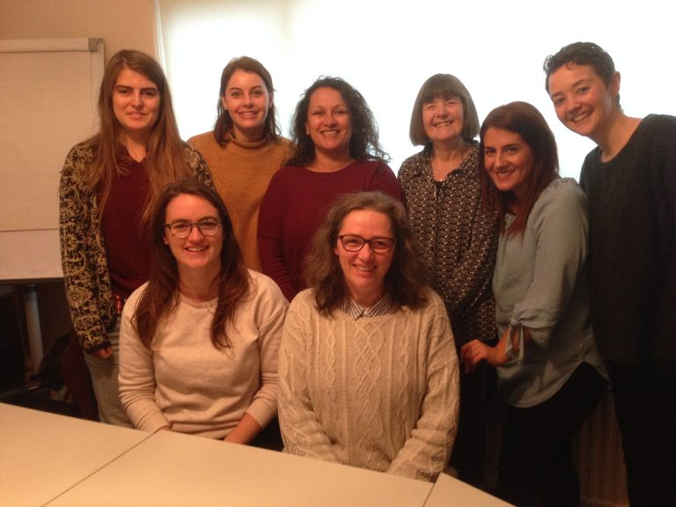
Alternatives Trust
The Alternatives Trust offers support to women with their pregnancy choices following pregnancy loss, and provide an advocacy service for families. They aim to provide holistic, practical, relational and educational support to mums in distress. The Evaluation Exchange UCL research team is made up of Jeanne Wolstencroft (PhD candidate at the Institute of Child Health), Laura Silva (PhD candidate in Department of Philosophy, Stephanie King (PhD candidate in History of Art) and Jessica McCormack (Researcher in LMCB). Since September 2017 Alternatives and UCL researchers have been working together to develop an evaluation framework that will effectively gather information about the value and impact of the We Are Family programme, and piloting new evaluation tools.
Key lessons learnt:
The team learnt first hand the difficulties faced by the charity when it comes to logistics of monitoring and evaluation when working with vulnerable people. It was important to really understand the challenges faced by the organisation, in order to think through possible solutions.
The team worked extremely well together. As part of the Evaluation Exchange programme the team were carefully matched to meet the needs of Alternatives Trust, as well as ensuring that the skills and experience of the researchers would compliment each other.
“I have been impressed with the enthusiasm and thoughtful application of our research team” (Alternatives Trust)
Key impacts
“Sometimes working in academia you can feel a bit disconnected from the real world, so it’s great to be able to get involved in a project where you can put your skills to practical use.” (UCL researcher)
The UCL researchers found learning about the work of Alternatives a great experience.
The project has resulted in Alternatives Trust having a way to measure things that they previously couldn’t. They have a comprehensive evaluation framework with a wide range of indicators, so that they can accommodate funders’ requests without spending more time in the office than running the projects.
Through the Evaluation Exchange a network has been created between Alternatives Trusts and another organisation who provide similar services to communities in Newham.
Next steps
The next stage is to implement the evaluation framework.

Slide 4
The Evaluation Exchange
UCL’s Public Engagement Unit (PEU) have partnered with east London charity Aston-Mansfield to pilot an exciting new project: The Evaluation Exchange. The Evaluation Exchange aims to pair the skills of 23 researchers from UCL (ranging from PhD candidates to Research Associates) with six Voluntary Community Sector (VCS) groups from Newham for a six month period. We have supported these teams to work together to tackle an evaluation challenge — whether it be writing reports, analysing existing data or designing an evaluation strategy.
The Evaluation Exchange has been funded by UCL’s Innovation and Enterprise’s Knowledge Exchange and Innovation Fund. Its aim is to “connect the know-how to the how-to” giving researchers a valuable opportunity to apply and develop their research skills and gain ‘hands-on’ experience of the voluntary sector, and VCS organisations a chance to build capacity for effective evaluations. The ethos of the Evaluation Exchange is connection, collaboration and experimentation– working together, trying new things and seeing what grows from them.
Key lessons learnt:
Key impacts
We created a structure for the programme, organising three training session during the life of the project, but wanted to allow flexibility for the openness of learning. However, some groups and individuals clearly wanted direction and information, rather than finding their own way to work together. It was challenging to work out what support the teams needed from us, particularly if they didn’t ask!
The seed grants have been vital for some, useful for others and not taken up by all. This is surprising as we thought they would be useful for all. We wonder if groups have felt they’ve received so much through the project they haven’t been as proactive as they might have been about the grants.
It was surprising that so many of the researchers thought they didn’t know anything about evaluation - but then showed that they knew a lot.
This has been an enjoyable, exciting project for us. An example of genuine partnership working and one that has clearly benefited the organisations and the researchers involved
We feel we have achieved what we initially wanted to – and in some areas the programme has exceeded our expectations.
We know that the project has been demanding time-wise for the teams but our sense is that the benefits are such that although the teams are spending more time on it than expected people feel it’s a worthwhile investment
It has been heavily reflective – partly because it’s the first time. We’ve learned a lot along the way and we really hope we get the chance to put our learning into action to run this programme again.
Next steps
We would like to run the Evaluation Exchange again, and are looking into ways of doing this.

Slide 5
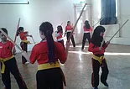
Modern Arnis
Modern Arnis London is a community interest company that teaches Filipino martial arts to children and adults in Newham, offering funding available for children who cannot otherwise afford to learn this sport. The UCL researchers were Helen Macintyre (PhD candidate in the Institute of Education), Joe Thorogood (PhD candidate in Geography), Eseelle Hendow (PhD candidate in the Division of Medicine). The team’s role was to come up with a framework and tools for evaluating the children’s classes.
Key lessons learnt:
There is a need to be realistic with what can achieved during the length of the programme. The 6 months goes by fast, particularly if there are a few hurdles along the way, so it’s important to stay focused and think about what you need to achieve.
In terms of developing evaluation tools: Keep it simple. Look for simple tools that can be used again without too much effort. This will make it sustainable in the long term.
As with any group project, there is a need to understand other peoples commitments, outside of the project, and it is important to know not everything is within one’s control.
The Evaluation Exchange was a highly reflective programme, as it was a pilot, but this reflective approach did not suit all the researchers involved.
“Evaluation Exchange has given me experience of directly working with a VSO in a way that is meaningful – I think – for that organization and should make a real different to [their] fundraising activity. It’s made me wonder if a similar approach can be used for engaging schools in research and with researchers” (UCL Researcher)
Next steps
Key impacts
Modern Arnis have a plan on how to implement their tools, but they are also seeking further opportunities to support this project further, whilst one of the researchers involved in this team is exploring how this model could be applied to schools.
The team created some evaluation tools that mean that the children who attend the classes can participate in evaluating it. There are three tools in total: one that is completed by the session lead, one by the children and one by the parents. These tools make it nice and easy to evaluate.
Through the process of developing the tools some useful feedback was collected which has now been used in funding applications for Modern Arnis. They now have reliable data than can be used for a variety of things in the future, not just funding applications
“It has been amazing: great researchers, very efficient and focused group. It has helped me to reflect more on what I am doing”. (Modern Arnis)

Slide 6
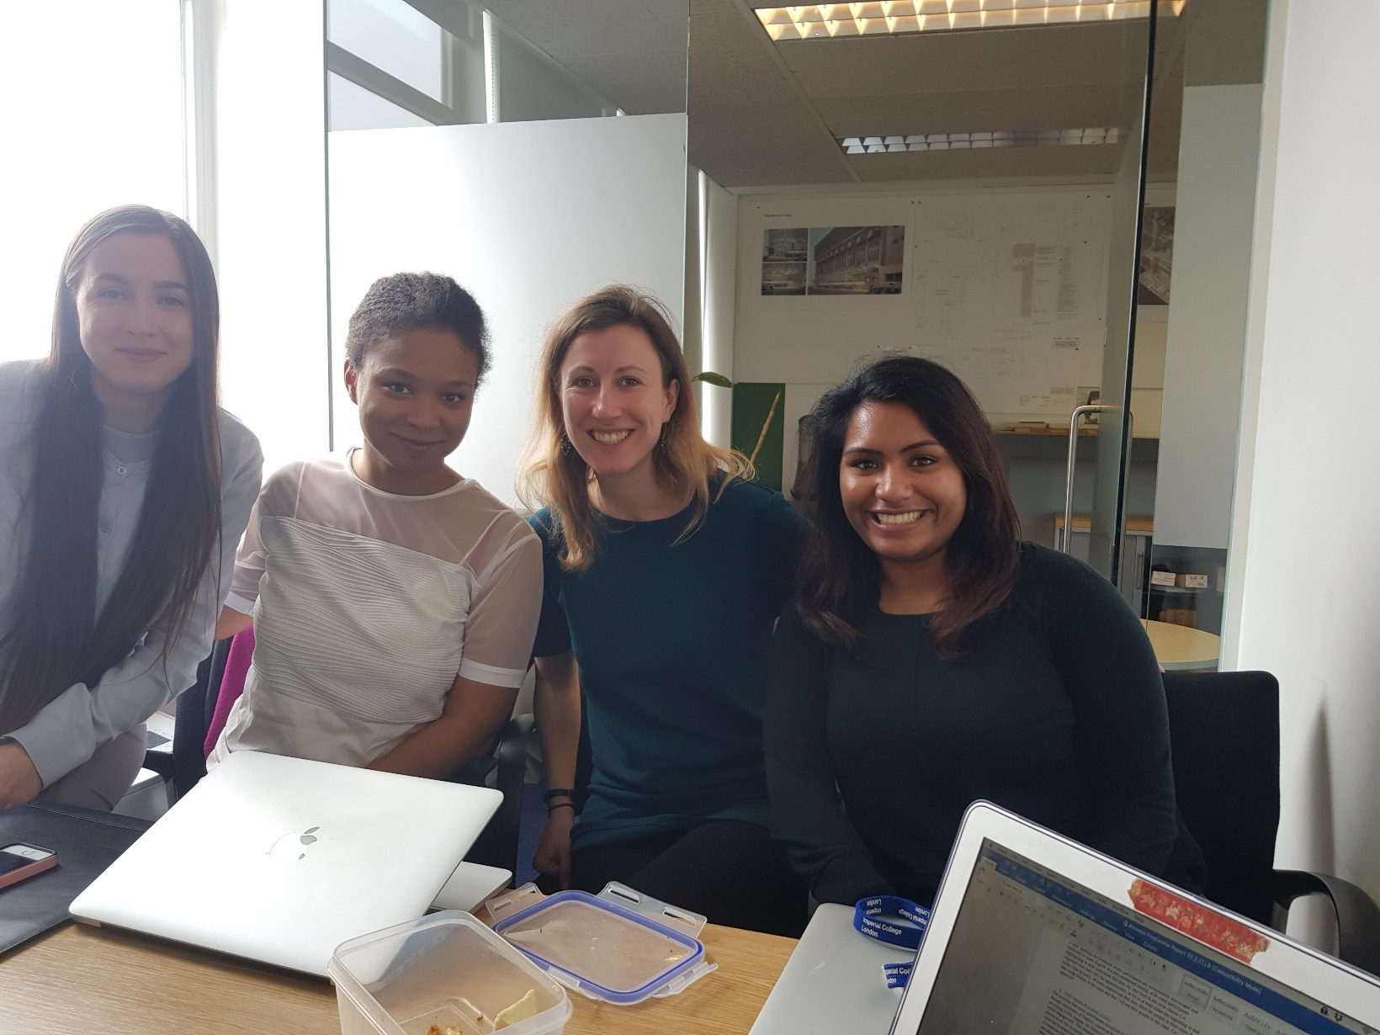
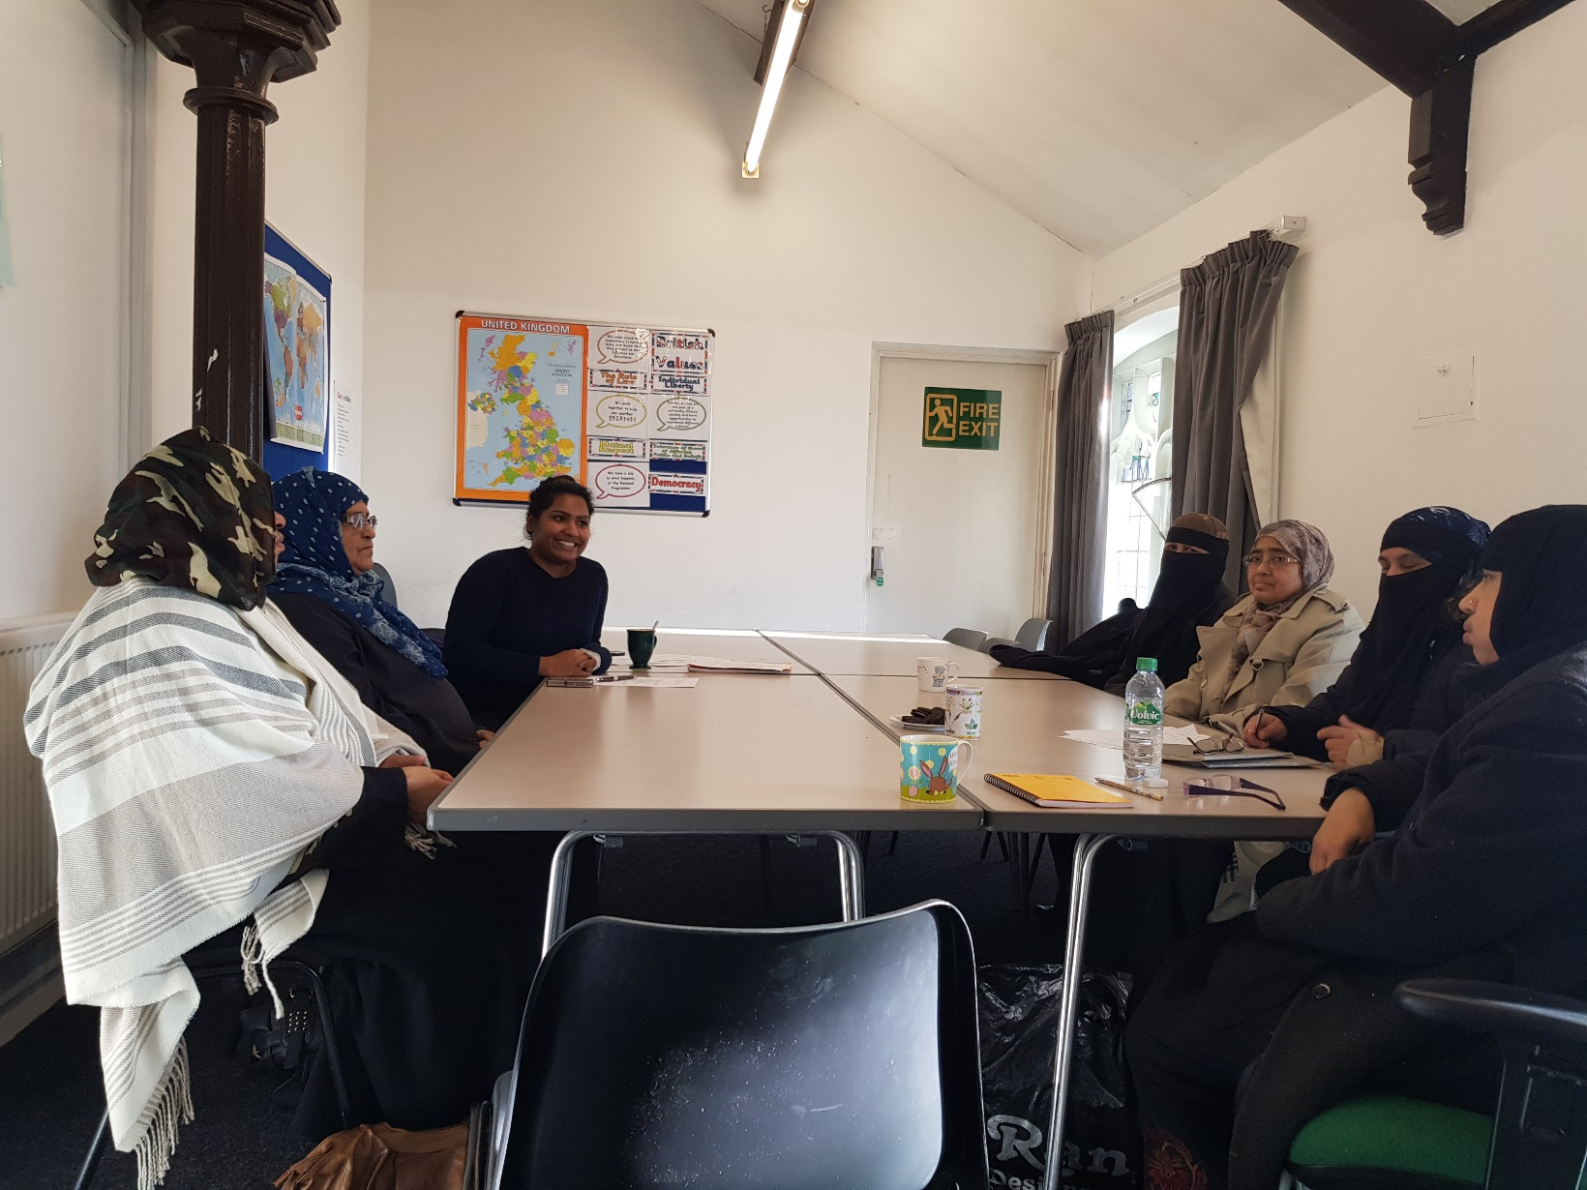
The Renewal Programme
The Renewal Programme offers a range of activities, from ‘keep fit’ classes to Maths and IT training, alongside running ESOL (English for Speakers of Other Languages) classes to ladies over sixty years old. This class is targeted to complete beginners and differs from other English classes as it is volunteer-led, women only, and adapted to learners’ special interests and needs. Since September 2017, The Renewal Programme have been working with Alexandra Bulat (PhD candidate School of Slavonic and East European Studies), Sarah Jasim (Research Associate, Institute of Epidemiology & Health), Lioba Hirsch (PhD candidate Department of Geography) and Lorna Benton (Research Associate Institute of Child Health) to work together answer the following question: What impact does the non-traditional Renewal Programme ESOL class for women over 60 have on the lives of its participants?
“Working on our evaluation project with the Renewal Programme has been inspiring and insightful. On days when I felt overwhelmed with work, talking to the women at the Renewal Programme proved invigorating and fun”. (UCL Researcher)
Key lessons learnt:
The findings of the scoping research indicates that the ESOL classes are an essential part of the ladies’ lives, offering them not only an opportunity to practice, but also a much-needed supportive social space in which they feel comfortable.
The team used a mixed methods approach to evaluate the ESOL programme, undertaking participatory workshops and interviews.
The team spent time understanding the organisation, and learning about the need for effective and appropriate evaluation and difficulties of reflecting the social impacts.
“I have loved every minute of working with my wonderful and super-efficient researcher team; completely different yet complementary, I have learned such different ways of working that I will continue to use, thanks to you”. (UCL Researcher)
Key impacts
The UCL researchers have gained insights into a community organisation, as the Renewal Programme, describing their work as inspiring.
The project was a chance to integrate research practices and ideas from others on our UCL research team, who are from different disciplines, with the team reporting that they learnt from each other.
Next steps
The team have created a questionnaire that can used to evaluate the impact of Renewal’s ESOL classes in the future, as well as a video and written report showcasing the findings of the evaluation.

Slide 7
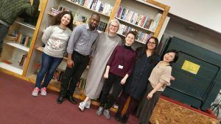
Caritas Anchor House
Caritas Anchor House (CAH) is based in the London Borough of Newham, where one in 25 people are homeless – the highest in Britain. By providing accommodation, education and guidance for single homeless adults, the charity aims to ensure that all those who walk through their doors grow in confidence, and move towards leading independent, self-fulfilling lives. During the Evaluation Exchange UCL researchers Anne Laybourne (Research Associate, Division of Psychiatry), Joana Neves dos Reis (PhD candidate, Biochemical Engineering), Jean Xu (PhD candidate, Bartlett School of Planning and Project management) and Aradhna Kaushal (PhD candidate, MRC Unit of Lifelog Health and Ageing) have worked with CAH to co-develop a tool to evaluate CAH’s services, and then incorporate CAH residents’ voices into decision making at the charity.
Key lessons learnt:
Managing expectations at the beginning of the project is really important. The team had big ambitions for this project and had to scale those back given the short time frame. The initial method proposed for collecting data was not feasible due to the length of the project.
It was really important that members of the team from CAH were able to dedicate quite a bit of time working on this project – and that this was built in to their work plans.
The building of relationships within the team, and getting to know everybody's expertise, was crucial for the project to be successful. It takes time to get to a level where efficient working can happen.
The team had to think about ways in which they could capture honest and constructive feedback from the residents at CAH.It was important that former and current residents of CAH were a part of the planning process.
The data collection had to be approached sensitively- and done in a way that didn’t jeopardise the trust that exists between CAH staff and CAH residents. The variety of languages spoken by the team and the researchers helped a lot in interviewing the residents.
Key impacts
The team used an evaluation method called Nominal Group Technique (NGT). Through the NGT sessions the team have managed to collect a large amount of information to inform the service that CAH provides.
The NGT sessions proved to be extremely popular amongst residents and as a result this is something that CAH would like to run annually.
CAH have already been able to implement some changes for improving their service- based on the findings of the evaluation.
Next steps
A lot of material will been produced from this project, including a video, a ‘How To Guide’ on running NGT sessions at CAH, a report on the findings, and a list of recommendations for CAH to increase resident satisfaction with the service. CAH will be using this material to improve the delivery of their services.
“My experience has been beyond measure. The knowledge sharing is a valuable asset and skills that will be a ‘take-away’ for me” (CAH)
“I am aware now of all the constraints faced by VSOs when working with vulnerable populations including ethics, power dynamics, bureaucracy, funding etc.” (Researcher)

